Slide 1
BUS RESERVATION SYSTEM
Priyanshu Shrivastava – RA2111003011678
Abhinav Kumar – RA2111003011701

Slide 2
OBJECTIVE: -
This is Visual-Basic Projects on Bus Reservation System, which provided a lot of facility to their user.The objective and scope of my Project Bus Reservation System is to record the details various activities of user. It will simplify the task and reduce the paper work. During implementation every user will be given appropriate training to suit their specific needs. Specific support will also be provided at key points within the academic calendar. Training will be provided on a timely basis, and you will be trained as the new is Bus Reservation System rolled out to your area of responsibility. At the moment we are in the very early stages, so it is difficult to put a specific time on the training, but we will keep people informed as plans are developed. The system is very Userfriendly and it is anticipated that functions of the system will be easily accessed by administrators,

Slide 3
academics, students and applicants. Hence the management system for the College management has been designed to remove all the deficiency from which the present system is suffering and to ensure.
PROBLEM DEFINITION: -
This system is based on a concept to reserve bus tickets. From this system, the user can view bus list, book tickets, cancel bookings and check bus status board. While booking tickets, the user has to enter bus number then the system displays total bus seat numbers with passenger's name and the user has to enter the number of tickets, seat number, and name of the person. Here, cancel booking also features refunding. Login system is also available in this system to make it more secure. There’s no chance of data misuse or loss & it’s not time-consuming. The whole project is developed in ‘C’ Programming language, different variables and strings have been used for the development of this project. It’s easy to operate and understand by users.
FLOW CHART: -

Slide 4
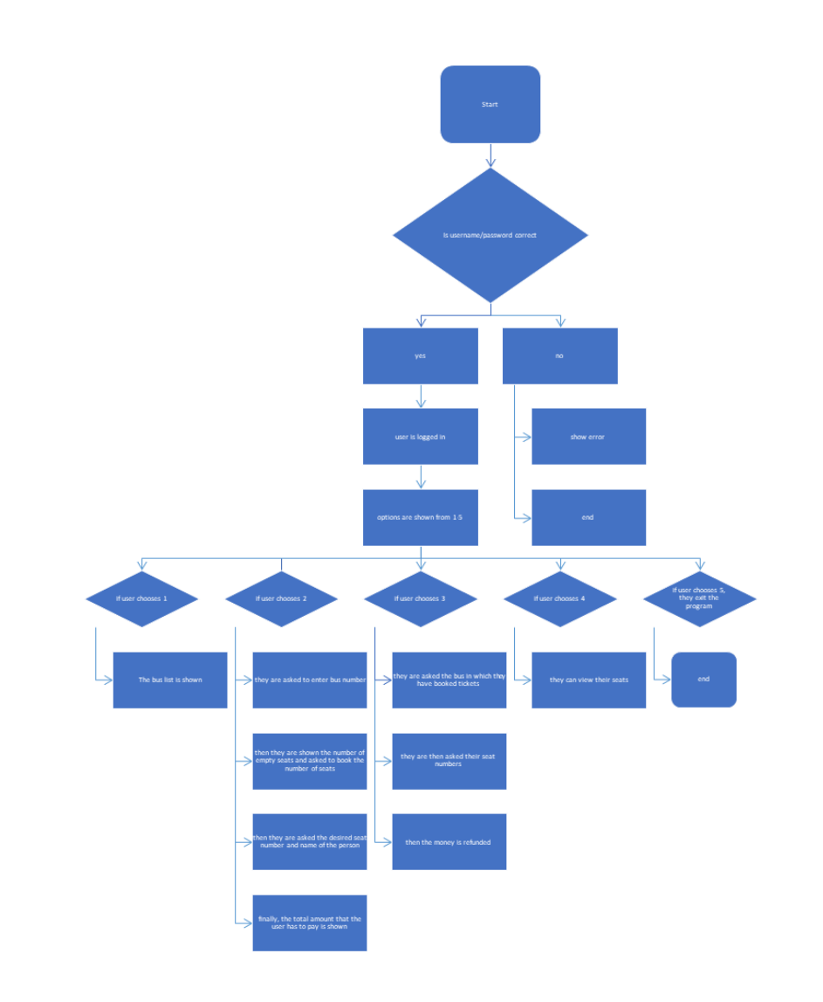

Slide 5
ALGORITHM: -
SCREEN-1
Ask user to give input by asking for username and password.
Ask the user to enter the password. If username and password are correct, Allow them to the next slide. Else, Display an error message.
SCREEN-2 Display message with the words, “Welcome to Bus Reservation System.”
Display the available options, with their respective numbers.

Slide 6
If user chooses 1:
SCREEN-3
Display all available buses, with their respective numbers.
If user chooses 2:
SCREEN-3
Display all available buses, with their respective numbers.
Ask the user to enter the required bus number.
Depending upon the number the user enters, show the respective bus, and the available seats the bus has.
Ask the user the number of tickets they require.
Depending upon the number the user enters, ask for the desired seat number, and the name of the person.

Slide 7
Finally, print the amount required to be paid by the user. The cost is Rs 200 per ticket.
If user chooses 3:
SCREEN-3
Ask the user for the bus number.
Show all the seats in the bus, and ask the user which seat they want to cancel.
Once the user has cancelled the ticket, display a message saying that their money has been returned
If user chooses 4:
SCREEN-3
Depending upon the number the user enters, show the respective bus, and the available seats the bus has.

Slide 8
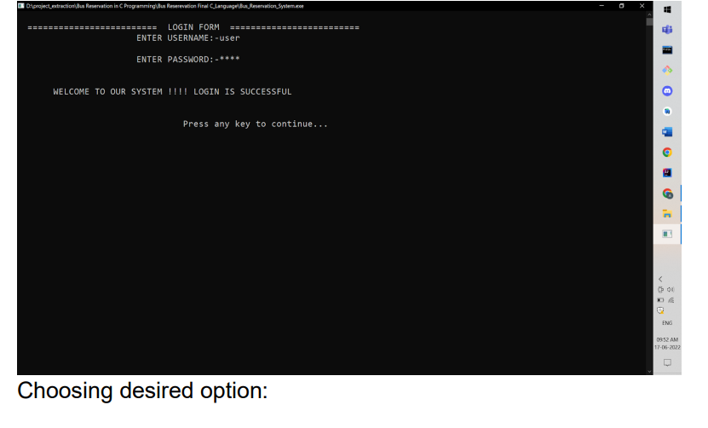
If user chooses 5:
SCREEN-3
Exit out of the program. OUTPUT SCREEN: -

Slide 9
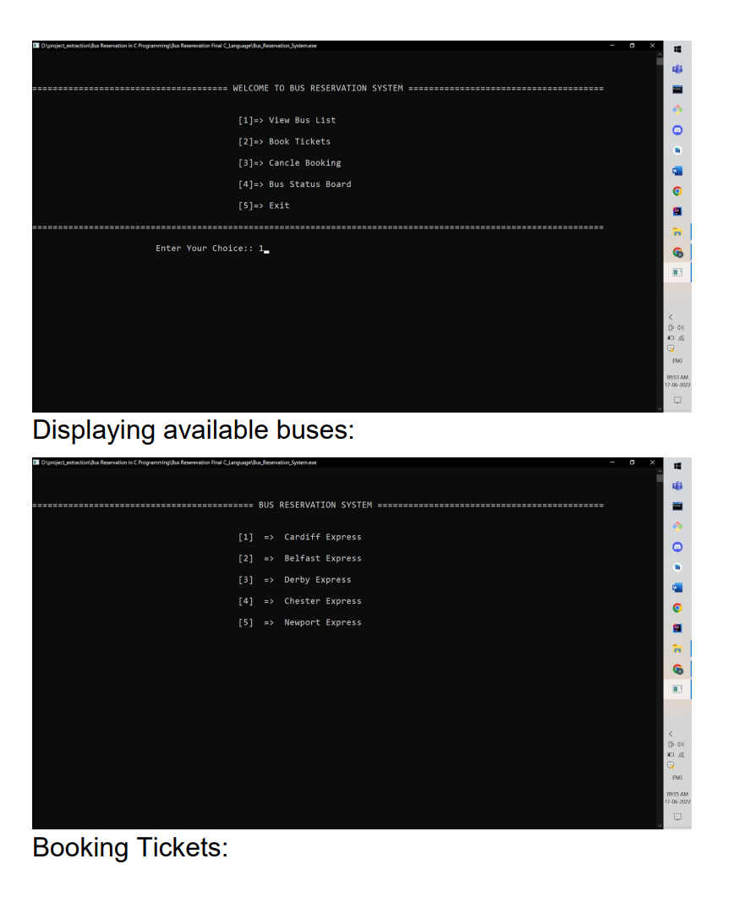

Slide 10
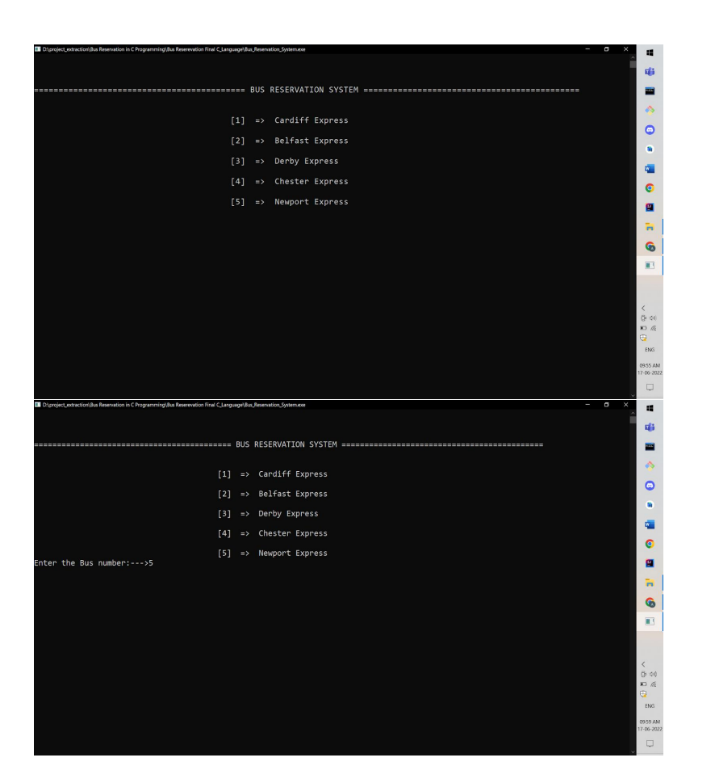

Slide 11
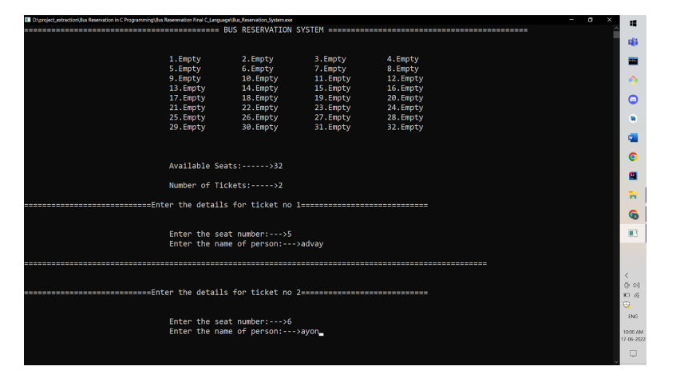

Slide 12
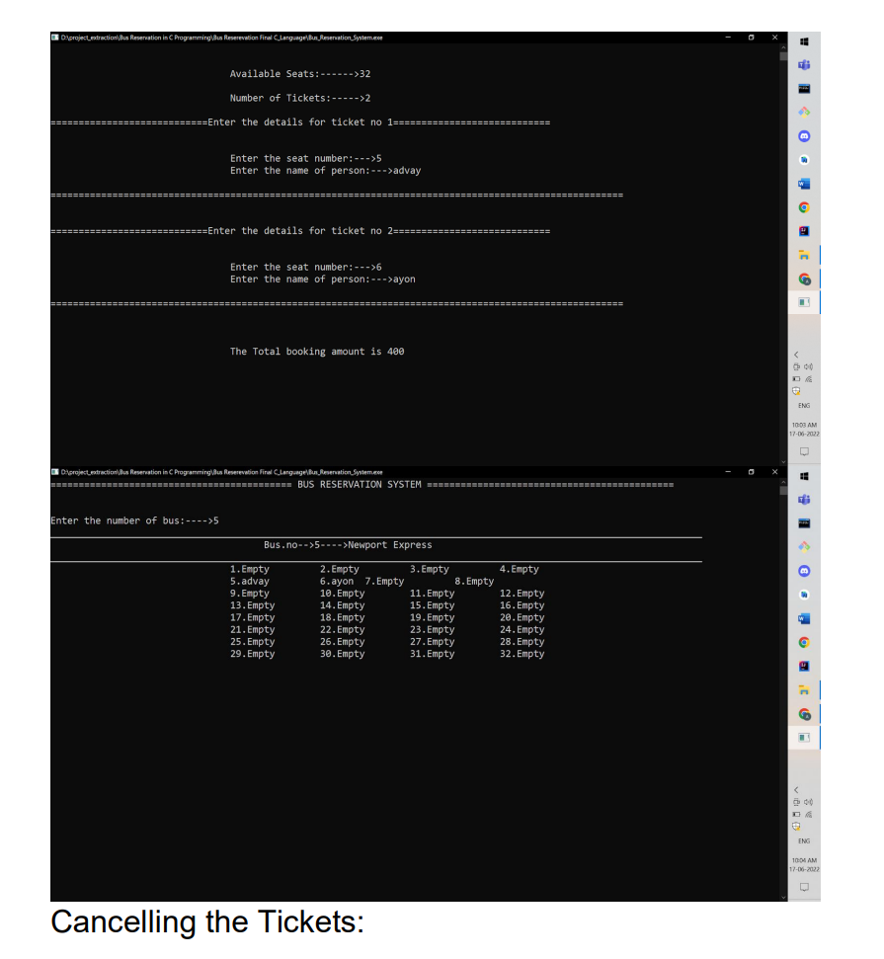

Slide 13
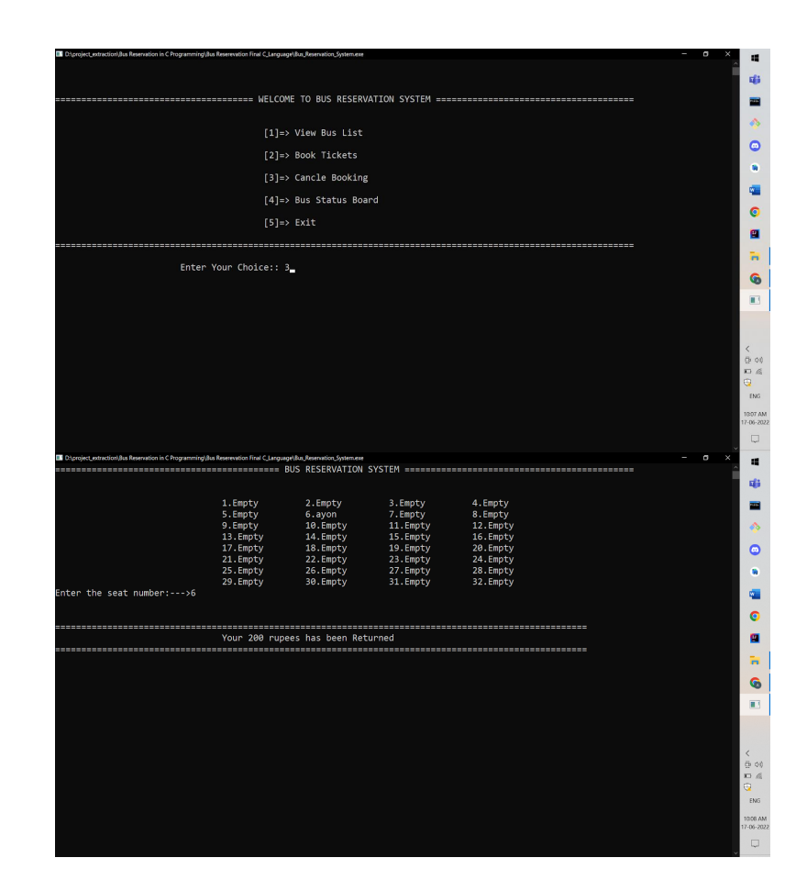

Slide 14
